Slide 1
Lead Scoring Case Study

Slide 2
Problem Statement
An education company named X Education sells online courses to industry professionals.
X Education gets a lot of leads, its lead conversion rate is very poor. For example, if, say, they acquire 100 leads in a day, only about 30 of them are converted.
To make this process more efficient, the company wishes to identify the most potential leads, also known as ‘Hot Leads’.
If they successfully identify this set of leads, the lead conversion rate should go up as the sales team will now be focusing more on communicating with the potential leads rather than making calls to everyone.
Objectives
To build a logistic regression model to assign a lead score between 0 and 100 to each of the leads which can be used by the company to target potential leads.
A higher score would mean that the lead is hot lead, i.e. is most likely to convert whereas a lower score would mean that the lead is cold and will mostly not get converted.

Slide 3
Solution Methodology
Data Understanding, Cleaning and Preparation
Reading the data and looking for duplicates if any
Looking at the info and statistical summary of the data
Handling missing values and treating outliers
Analyzing Variables and the behavior of variables with target variable using visualization
2. Train - Test split and scaling
3. Model Building
Coarse Tuning using RFE
Manual Fine Tuning using VIF and p-value
4. Model Evaluation
Accuracy
Sensitivity and Specificity
Threshold determination using ROC
Precision and Recall
5. Predictions on Test set

Slide 4
Data Manipulation
Number of columns : 37 and Number of rows : 9240
There were no duplicates observed in the dataset
Dropped 'Prospect ID' and 'Lead Number' columns as they just act as unique identifier
Replaced ‘Select’ values with np.nan as ‘Select’ stands for missing values
Dropped the columns for which percentage of missing values is > 45%
Imputing the missing values of the variables with ‘Not Specified’ where percentage of missing value is high
Imputing the missing values of the variables with mode where percentage of missing value is comparatively low
Created separate category called ‘Others’ for low frequency values in a variable
Dropped all those variables where most of the values were 'No’ considering those as least helpful in analysis
Handled outliers of numerical columns by using ‘capping’ method
Conversion rate was 38%

Slide 5
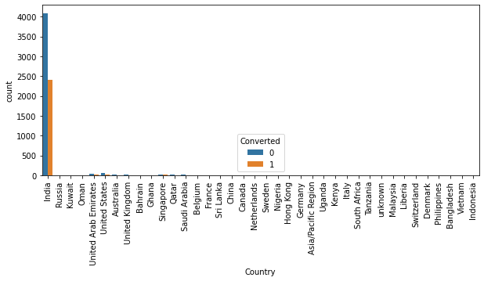
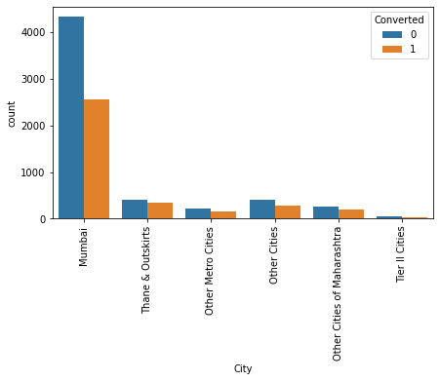
EDA
Analyzing ‘Country’ and ‘City’ variables
Almost all of the visitors/leads are from India out of which most were from Mumbai
Dropped country variable considering it as insignificant for analysis.

Slide 6
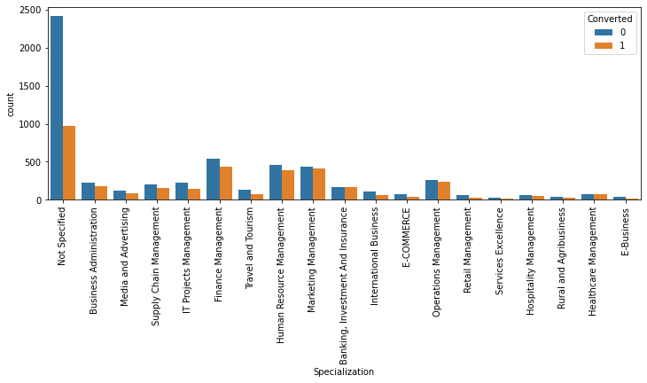
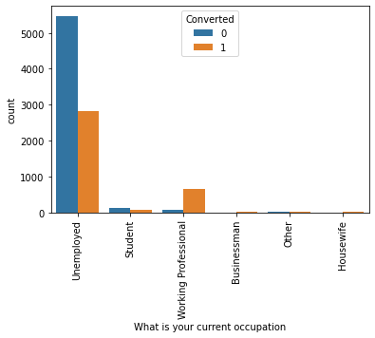
Analyzing 'Specialization' and 'what is your current occupation’ variables
There are multiple categories in ‘Specialization’ which is related to 'management' profile. Hence, clubbed those into a single category called as ’Management’
Working Professionals are more likely to get converted as learners

Slide 7
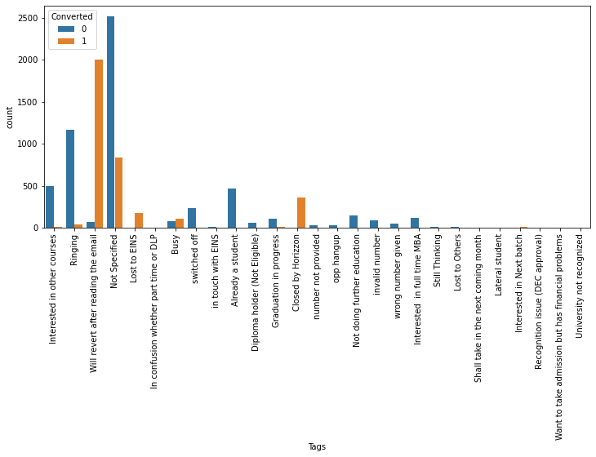
Analyzing 'Tags' variable
leads who are tagged as 'Will revert after reading the email' and ‘Closed by Horizzon' are likely to get converted.

Slide 8
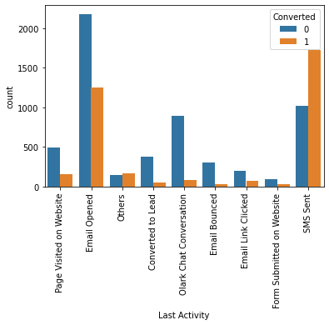
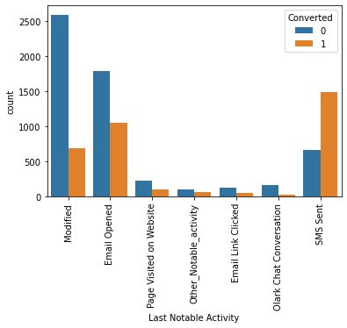
Analyzing 'Last Activity' and 'Last Notable Activity' variables
Leads who are mapped as ‘SMS Sent’ are more likely to get converted whereas percentage conversion of ‘Olark Chart Conversation’ being the least
Leads who are mapped as ‘Email Opened’ are also contributed significantly towards the conversion rate

Slide 9
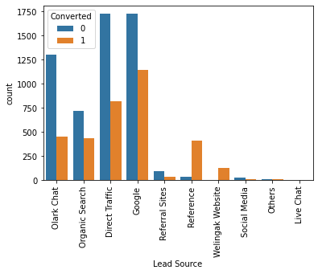
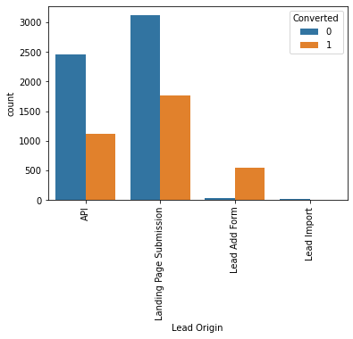
Analyzing 'Lead Source' and 'Lead Origin' variables
Tags whose lead source is from ‘Welingak Website’ are more likely to get converted along with the leads who are through ‘Reference’. Tags from ‘Google’ are contributed majorly towards the conversion rate
Tags whose Lead Origin is ‘Lead Add Form’ are more likely to get converted. Moreover, ‘Landing Page Submission’ also contributed majorly towards the conversion rate

Slide 10
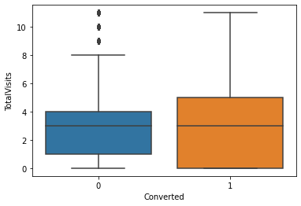
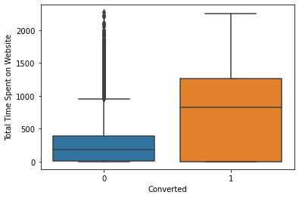
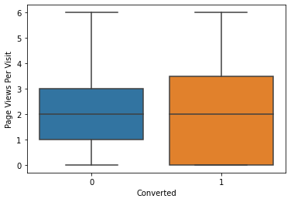
Analyzing behavior of numerical variables with the target variable
Even though median is same, upper limit is quite high for the converted visitors. Therefore, it means that visitors who visit the page frequently are likely to be get converted as learners.
If the visitor spend more amount of time in the website, more likely to him/her become learner.
Although the median is same for both of the ‘Page Views per Visit’, nothing can be concluded over here

Slide 11
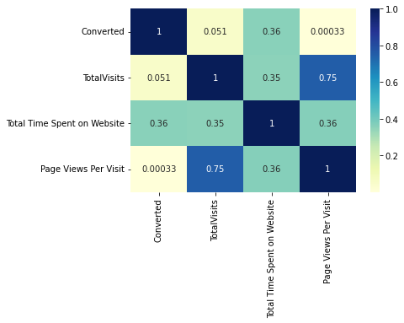
Looking at the correlation of numerical variables
'TotalVisits' variable is highly correlated with 'Pages Views Per Visit' variable which may be affected in our analysis
Target variable ('Converted') has a good correlation with 'Total Time Spent on Website' variable whereas least correlated with 'TotalVisits' variable

Slide 12
Preparing the data for modeling
Dummy variables were created for the categorical variables
Dataset was then split into train set and test set with 70:30 ratio keeping the random state at 100
Numerical features were standardized

Slide 13
Model Building
Coarse tuning using RFE
Top 15 most variables were selected using Recursive Frequency Elimination approach
Fine tuning using VIF and p-value
Built our first model using the variables selected by RFE method
Analyzed the model w.r.t the parameters such as p-value and VIF
Dropped ‘Last Notable Activity_SMS Sent’ as VIF > 5
Built our second model using the remaining variables
This model was considered as the optimal model where model was confident about all coefficient values obtained and also all the variables of a model had low VIF values which indicates that the variables are not much correlated with themselves (except target variable)

Slide 14
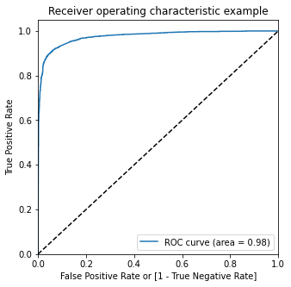
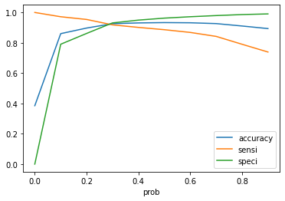
Threshold determination using ROC Curve
Optimal cut-off is the one which has balanced values of accuracy, sensitivity and specificity.
Therefore, 0.3 was considered as the optimal cut-off point

Slide 15
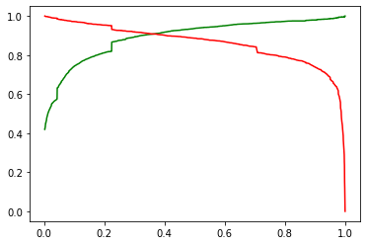
Precision - Recall curve
Green line represents precision and red line represents recall
For low threshold, precision is low and recall is high and for high threshold, high precision and low recall

Slide 16
Result Outcomes
Following are the results obtained on train set for the ideal cutoff of 0.3
1. Accuracy - 92.6%
2. Sensitivity - 91.8%
3. Specificity - 93.1%
4. Precision - 89.3%
5. Recall - 91.8%
6. F1_score - 90.5%
Following are the results obtained on test set for the ideal cutoff of 0.3
1. Accuracy - 91.4%
2. Sensitivity - 89.8%
3. Specificity - 92.2%
4. Precision - 86.8%
5. Recall - 89.8%
6. F1_score - 88.3%

Slide 17
Summary
Top three variables which contribute most towards the probability of a lead getting converted are :
1. Tags_Closed by Horizzon (7.05)
2. Tags_Lost to EINS (6.31)
3. Tags_Will revert after reading the email (5.01)
Some of the other important variables are
1. Lead Source_Welingak Website (3.80)
2. Last Activity_SMS Sent (2.11)
3. Lead Origin_Lead Add Form (1.28)

Slide 18
Conclusion
Company should focus on following features to increase the lead conversion rate
Tags_Closed by Horizzon: Leads that have been assigned Tags as ‘closed by horizon’ have the highest probability of conversion.
Tags_Lost: Leads that have been tagged as ‘Lost ‘also contribute to the conversion to a considerable extent.
Tags_Will revert after reading the email: Leads that have been tagged as ‘will revert after reading the mail’ also have significant correlation with the conversion.
In addition to this, it is advisable that the company ask the developing team to improvise the UI of an app so that the visitors can have a smooth experience and spend the considerable amount of time on the platform which may lead to get them converted as learners.
It is also advised that the company prioritizes the leads whose lead source is from ‘Welingak Website’ and also generate the leads as much as possible through this region.

Slide 19
Thank You

